Slide 1
Healthy Trinity Online Tool (H-TOT)
Deans Award for Innovation in Teaching 2016-17– Showcase event
Dr Catherine Darker
Department of Public Health & Primary Care
Chair of Healthy Trinity Committee
Healthy Ireland Council Member
Thursday 22nd June 2017
Mary O’Neill
Online Learning Technologist
School of Medicine

Slide 2
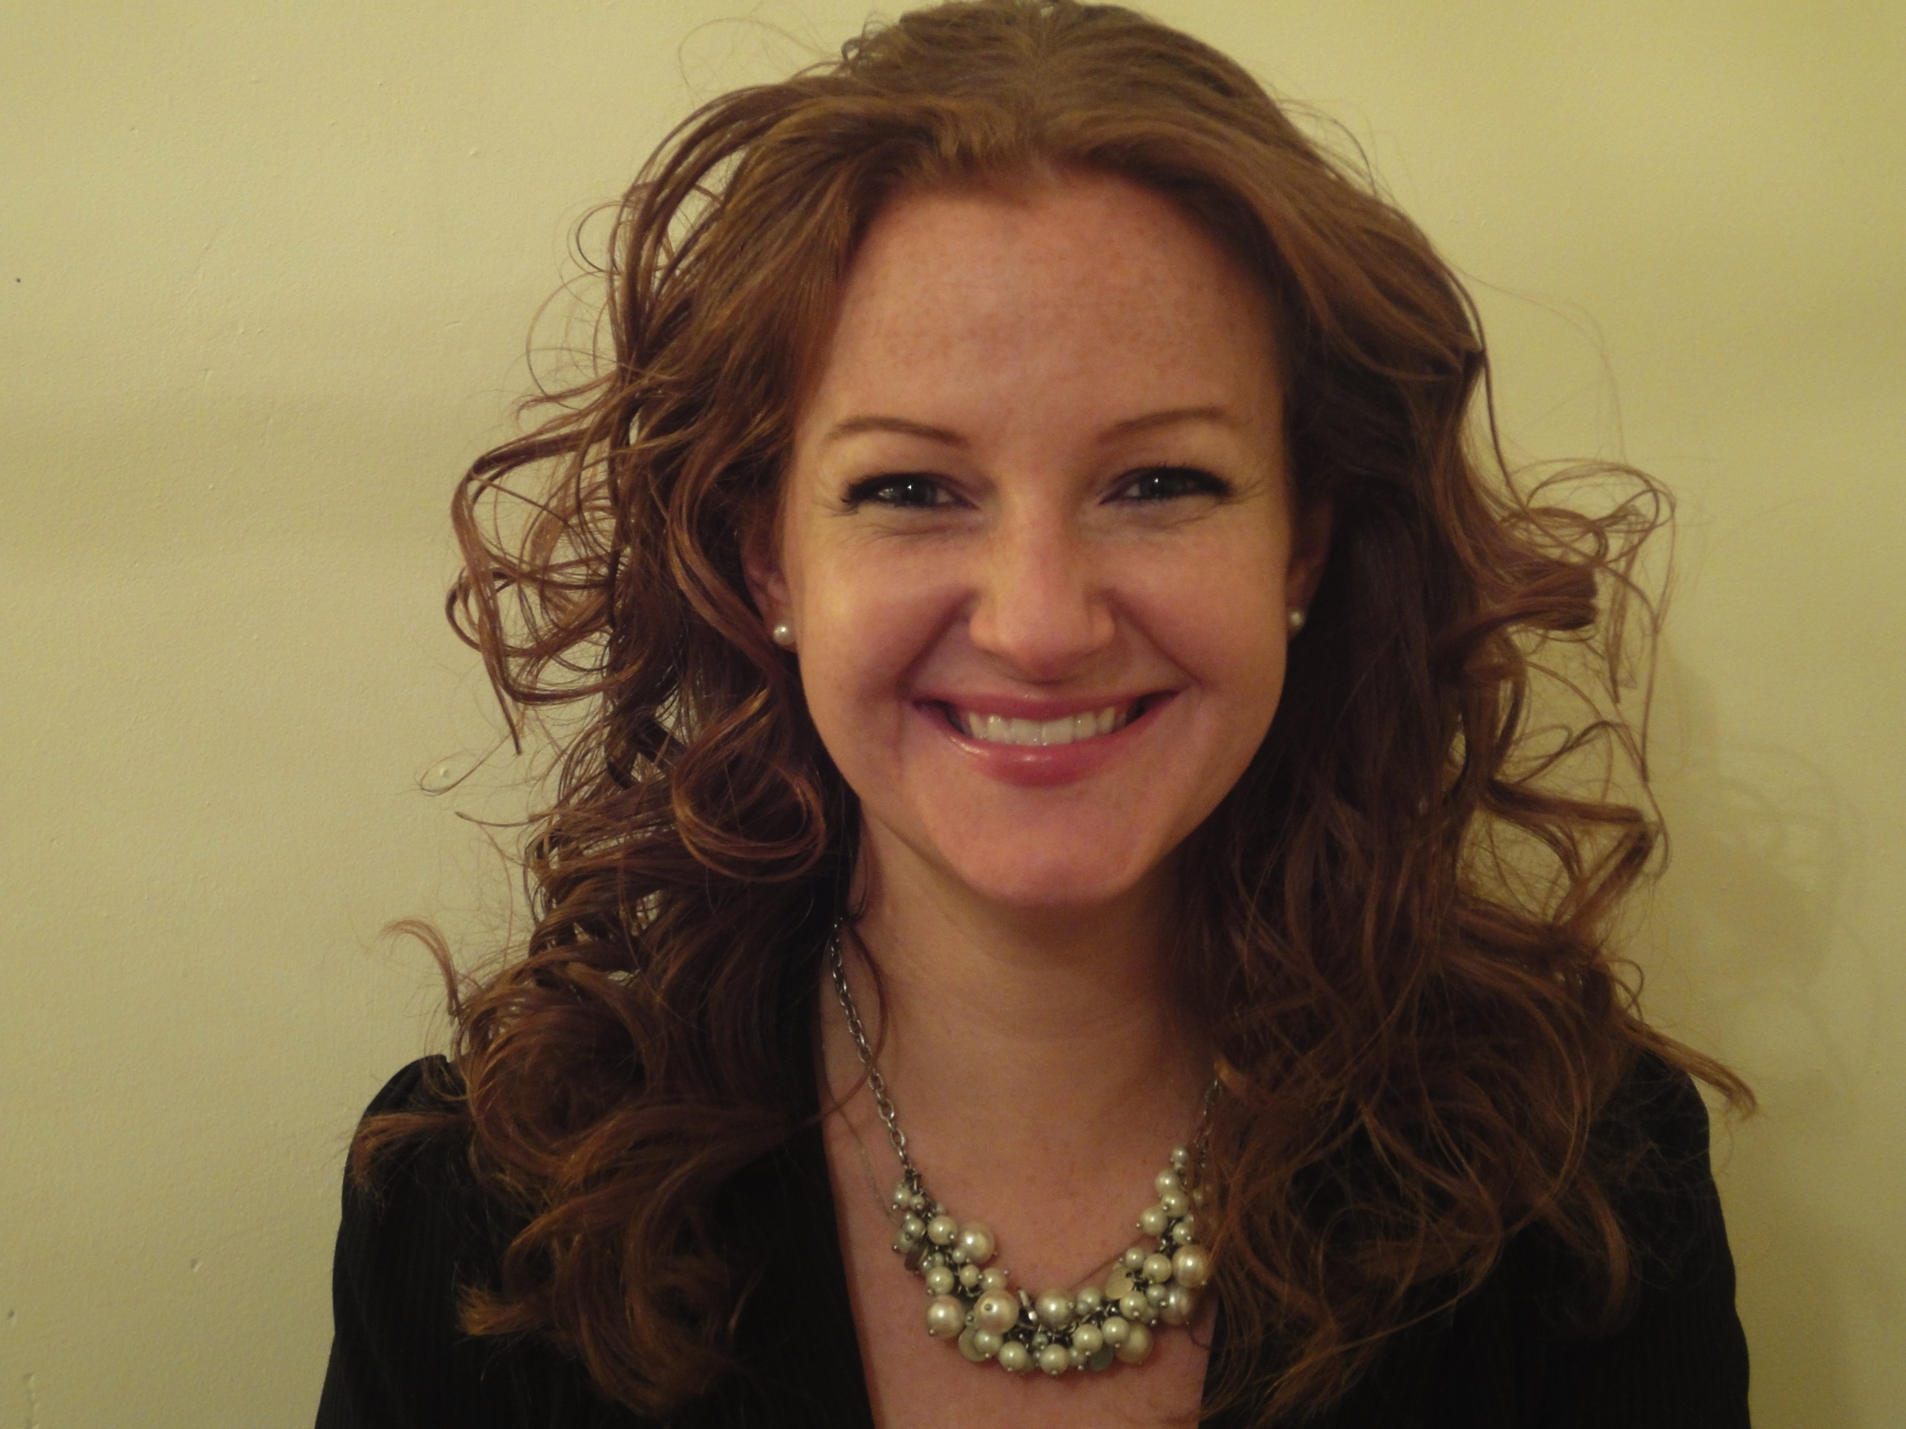
Dr Catherine Darker
Notes:
Project is the brain child of Dr Catherine Darker, PHPC

Slide 3
Rationale and Background of H-TOT
Healthy Ireland
Healthy Trinity – Healthy Campus Group
H.S. professionals and students – work/life balance
Notes:
Catherine is a council member of Healthy Ireland – this is a Government framework to improve the health and wellbeing of the population of Ireland by 2025.
Catherine was appointed by the Dean of FHS to be the Chair of the Healthy Trinity Group. The main aim of which is to implement Healthy Ireland within our community of staff and students.
Understanding that healthcare professionals have poor work/life balance, which can lead to burn out, absenteeism and impact negatively on the individuals own health.
The H-TOT is a complimentary tool for this initiative.

Slide 4
Aims of H-TOT
Target group:
1st year students (developed and piloted with 1st year medical students)
Aims:
to help to focus students on the importance of maintaining work-life balance throughout their career, through actively building this component into the undergraduate curriculum and
to deliver the health promotion aspects of the undergraduate medical curriculum in a way that it not only theoretical and evidence based but that includes practical applications from the outset.
Notes:
Aims
Whether its Medicine, Pharmacy, Nursing or Dentistry they all report a burn out at some stage of their career.
Some of our students are struggling especially with heavy curriculum loads.
H-TOT tries to endorse work/life balance within the early formative undergraduate training years.
Students should learn that having a good work/life balance is a good thing and will benefit them both personally and also professionally.

Slide 5
Objectives of H-TOT
Learning objectives:
To broaden and deepen students health and wellbeing knowledge.
To educate students about the existing supports and services within College to raise awareness of same and therefore facilitate access.
To increase students’ OWN health and wellbeing throughout their time at Trinity, and to develop lifelong habits of health and wellbeing and work-life balance.
Secondary benefit:
Bring together links to College support services in one area

Slide 6
Development of H-TOT
Design Development
The H-TOT tool has 6 major topics. Each topic covers a vast amount of information. As the tool has so much information driven content, it was decided to give each section its own individual style and identity, so the user was not lost in the tool with one uniform design theme running across the entire tool.
In Phase 2 such elements as video and voiceovers will be used. However Phase 1 has to rely heavily on the use of text, graphics, images and the user’s interactively
Quizzes were used as informative assessments, so the user can see how much they have learnt from the tool.
This tool was designed within Articulate Storyline 2 + 3 and exported to sit within the College’s VLE system, Blackboard.
Theoretical:
Locus of control
Self-Efficacy
Notes:
Locus of control =
Internal locas of control is where people believe that they have control over the outcome of events eg, when receiving exam results, they tend to praise or blame themselves and their abilities
As opposed to external locas of control - they tend to praise or blame external factors beyond their control, such as the teacher or the exam.
Self-Efficacy: they believe in their own capabilities to manage a challenge or to solve a problem.
People with strong self-worth believe that they can transfer skills from one domain to another. Having high self-worth is positive for a persons overall health.
1st year students are very young it is important to learn that they can be their own source of support.

Slide 7
Development of H-TOT
Topic guide:
Literature review
Tactic experience (decade in TCD), plus Health Psychologist
Survey of 1st year medical students
Focus group – in depth feedback from students on the tool (co-design)
Student selected module – n=14 1st year students ‘Prevention of Chronic Disease’. Course assignment.
Outcome:
interactive health related educational piece, with the functionality to enhance students’ ability to self-manage a challenge and signpost students to existing College supports, services and infrastructure.

Slide 8
Survey results

Slide 9
Demonstration of H-TOT
https://tcd.blackboard.com/webapps/blackboard/content/listContentEditable.jsp?content_id=_837539_1&course_id=_34150_1&mode=reset

Slide 10
Next steps for H-TOT?
? Phase 2
? Cover more topics and add additional features to the tool
? Release the tool to the Faculty of Health Sciences students
? Release the tool College wide

Slide 11
Thank You catherine.darker@tcd.ie mary.oneill@tcd.ie

